Slide 1
Tackling Gaps in Care Using Healthy Planet, FHIR, and the Duke Pillbox
Courtney Powell and Lynecia Cooper
With contributions by
Susan E. Spratt, MD

Slide 2
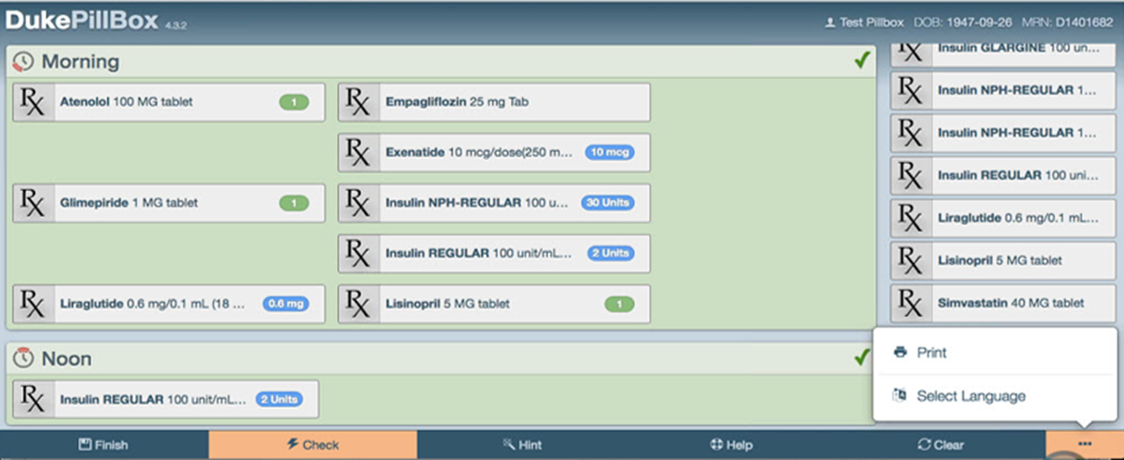
What is Pillbox?
The Pillbox application is designed to allow selected patients to increase their knowledge of their medication schedule. The application allows them to graphically select each medication and indicate the appropriate times of day they need to take each med.

Slide 3
Tackling Gaps in Care Using Healthy Planet, FHIR, and the Duke Pillbox
Adequate Blood Pressure (BP) Control in patients with diabetes mellitus (DM) can reduce and slow down progression of complications like kidney, heart disease, and stroke.
25-40 % of patients with diabetes do not achieve BP goal
  Duke Endocrinology 4700 pts with DM: 27 % not at goal
  DPC Range: 21K pts with DM: 21.3 % not at goal
Poor medication adherence is a major factor in creating gaps in care with an estimated 50 % of diabetes patients who do not take medications as directed.

Slide 4
Tackling Gaps in Care Using Healthy Planet, FHIR, and the Duke Pill Box
  Aim: Improve medication adherence and control of hypertension among patients with DM by implementing a Pillbox tool integrated within our EHR
  Providers use Dashboard to identify DM patients and BP above goal
  Offer patients the use of the electronic Duke Pillbox via MyChart
Notes:
What is the problem you are trying to solve?
Improve control of hypertension in patients with DM
Proposed solution/intervention
Use Dashboard to identify DM patients and BP above goal
Offer them the use of the electronic Duke Pillbox
Integrate Duke Pillbox with Duke systems using SMART on FHIR

Slide 5
Achievable Outcomes and ROI
Clinical Outcomes:
  Reduce hypertension in patients w/ diabetes
  Reduce A1c to goal
Quality and Processes of Care Outcomes:
  Improve AHA/ADA Guideline compliance
  Improve patient education, skill-based learning
  Improve medication reconciliation
  Improve patient satisfaction
Return on Investment
  Reduction in DM deaths and complications
  Preliminary data for research applications
  Population Health / Meaningful Use

Slide 6
Components of this Project
Healthy Planet Endocrine Dashboard
  Using Healthy Planet Dashboards to identify diabetic patients with BP not at goal
Recruitment of Patients
  Using Dashboard to generate Reporting Workbench report (RWB) to identify DM patients with gaps in care
  Using bulk communication method to generate MyChart message

Slide 7
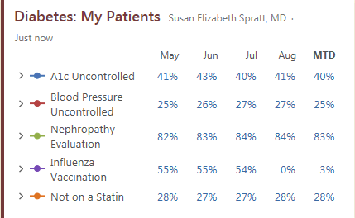
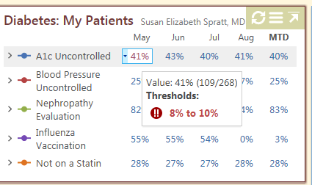
Healthy Planet Endocrine Dashboard
Hover here to see numerator and denominator

Slide 8
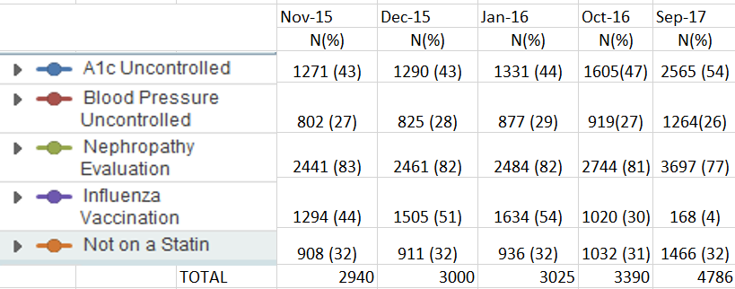
Healthy Planet Endocrine Dashboard
We now have 4786 patients on the Dashboard

Slide 9
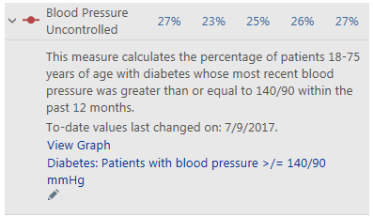
Using Dashboard to Create RWB Reports
CLICK HERE TO LAUNCH RWB

Slide 10
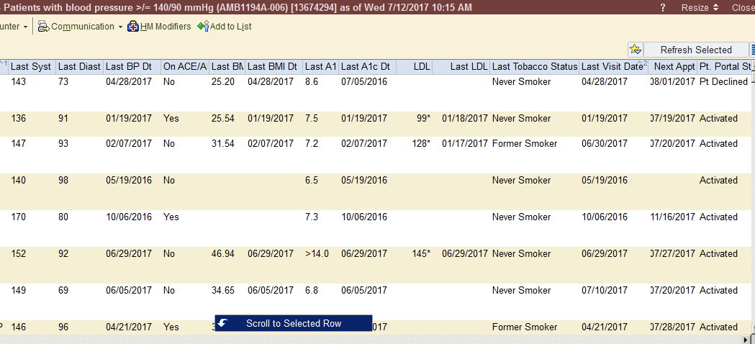
Identifying Patients for Duke Pill Box
LAST BP
& DATE
Patient on MyChart?
Patient on ACE/ARB?
Notes:
This is the report. You can trend on columns with actionable data. Then I can easily send a bulk communication offering patients a chance to participate in the Duke Pillbox project.

Slide 11
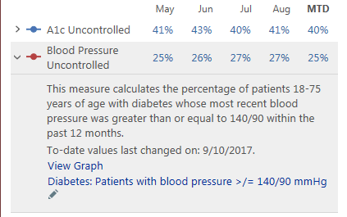
Using Dashboard to Create RWB Reports
CLICK HERE TO EDIT REPORT

Slide 12
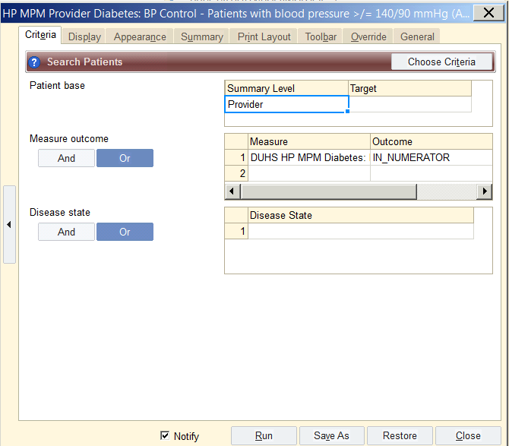
Changing Report from RWB
Change Summary Level
Measure
Outcome

Slide 13
Bulk Communication
MyChart Messages versus Letters
  No $ for stamps
  Use of Pillbox requires use of computer and internet.
  If patient is not connected to MyChart, they are not a great candidate for the Pillbox
Generate Reporting workbench reports and send data to secure server or secure email

Slide 14
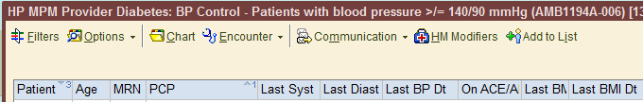

Bulk Communication
Use Bulk Communication to generate MyChart Message to a group of patients

Slide 15
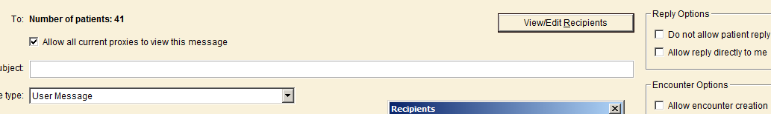
Bulk Communication
View Recipients and Remove Those who aren't
Candidates for the MyChart Message

Slide 16




Patient Recruitment
Responses to initial MyChart message
Pillbox to be launched in PRD

Slide 17
Adding Pillbox to MyChart
Smart Data Element
Modify features extension at login
Custom MyChart Security Point
Redirect placed on MyChart server that launches Pillbox

Slide 18
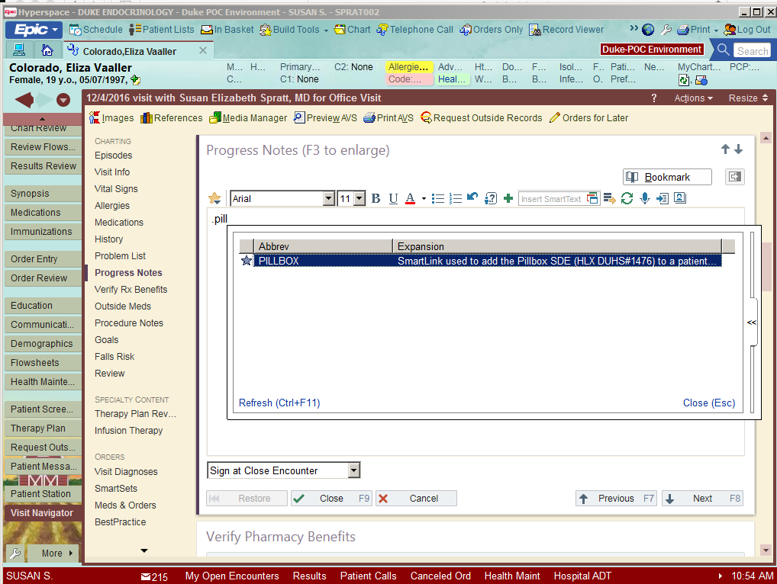
Pillbox Smart Phrase Implemented in Maestro
Created smart phrase with SDE that turns on Pillbox link within MyChart
SDE requested by IRB so that only patients who agree and are trained on the Pillbox will have access

Slide 19
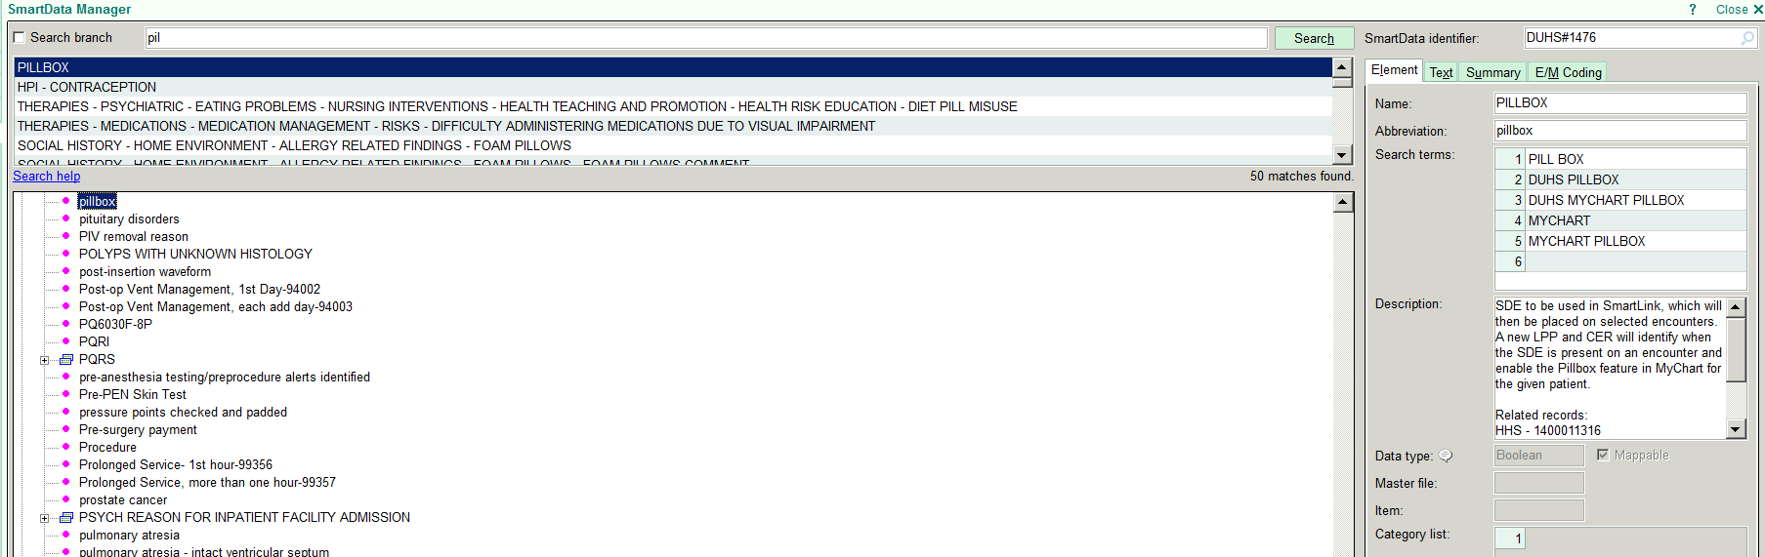
Smart Data Element
SDE is within a SmartLink, which may be placed on selected encounters.
  Charting; Progress Notes
  Telephone encounters

Slide 20
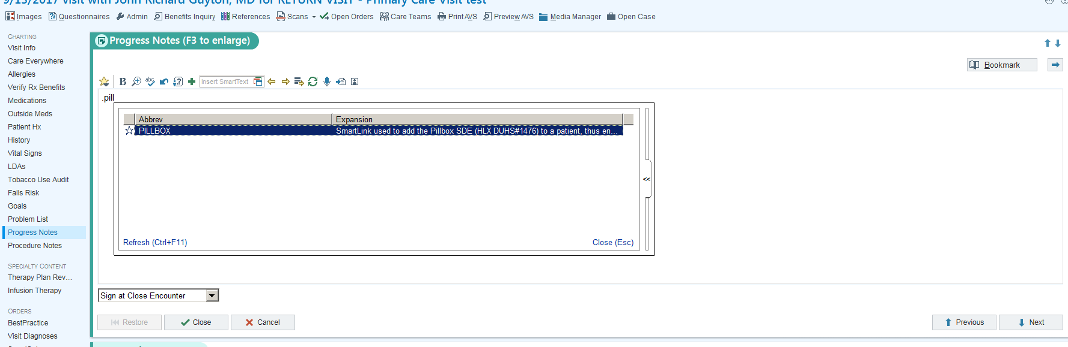
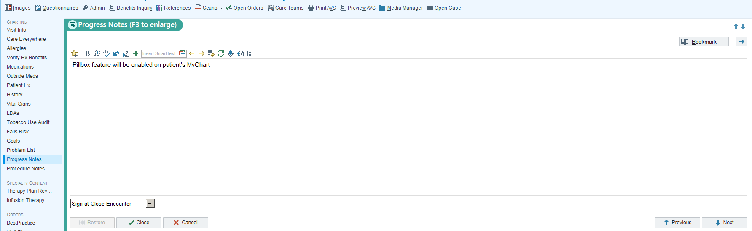
Use of Pillbox SmartLink & SDE

Slide 21
Adding Pillbox to MyChart
Extension and Rule identify when the Smart data element (SDE) is present on an encounter and enable the Pillbox feature in MyChart for the given patient.

Slide 22
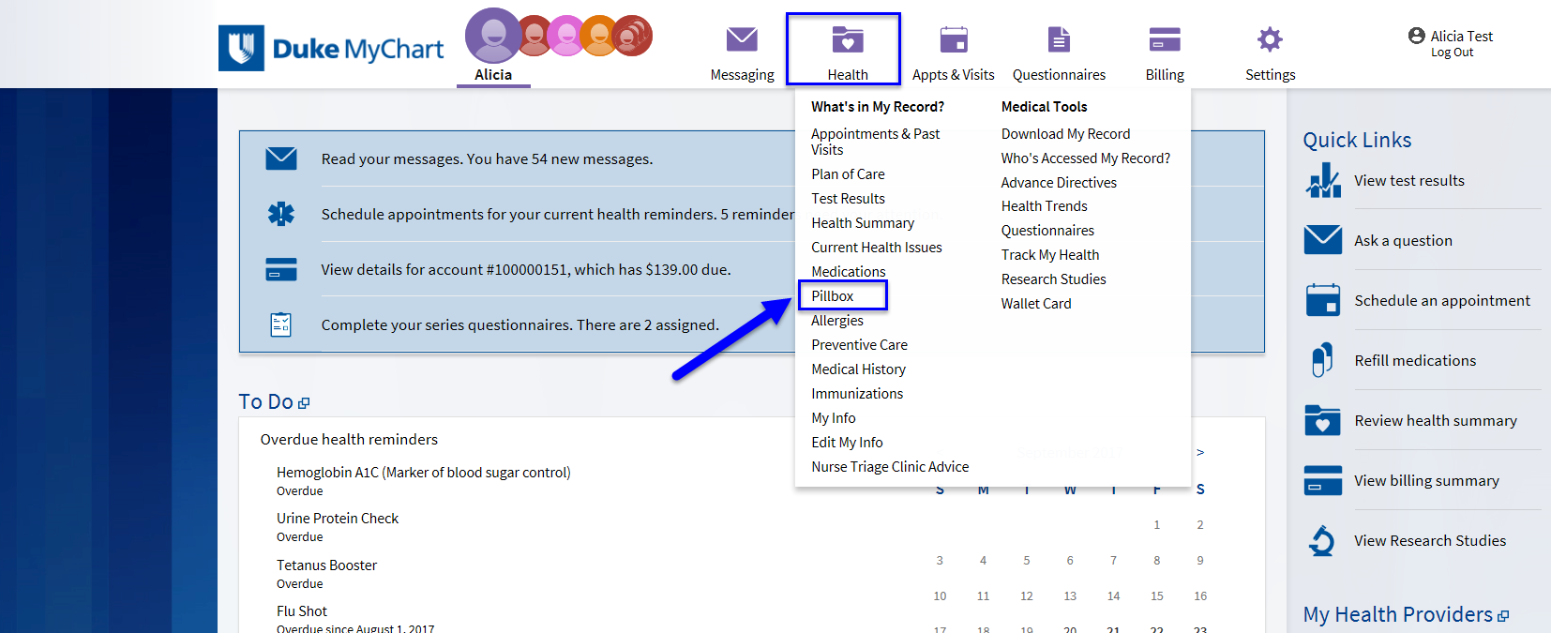
Duke MyChart

Slide 23
Clinical Components
Provider sends MyChart message to patient asking “Are you interested in Pillbox?”
Patient replies to the provider via a MyChart message: Y/N/No reply
If patient replies Y, nurse receives a notification in Patient Advice Request inbasket folder in Maestro Care; nurse sends to Provider or Pharmacist’s inbasket
Sets up phone call to review Pillbox and medications
Pharmacist’s Provides Patient with instructions to launch Pillbox via MyChart
Pharmacist adds .pillbox in progress note/Telephone note to enable Pillbox in patient’s MyChart

Slide 24

Pillbox

Slide 25
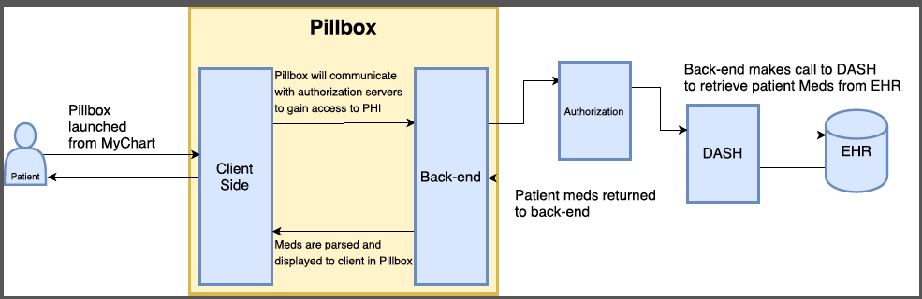
HL7-FHIR Pillbox Schema

Slide 26
Implementation Components
Secure a virtual machine behind the Duke firewall to house the data
Update medication list that the Duke Pillbox displays from Epic
Move the application from POC environment to production environment

Slide 27
Progress Update
Completed
Ongoing
Protocol development
IRB approval for exempt study
Contract with MedAppTech
Established secure folder for data storage
Identified & analyzed baseline population of patients with diabetes and uncontrolled hypertension via Endocrine dashboard
Designed Smartphrase that places Pillbox link in MyChart.
Designed and created link in MyChart to access Pill Box via SMART on FHIR
Initiated recruitment via bulk MyChart messaging using the dashboards of 12/19 Endocrine providers
How all injectables are interpreted in Pill Box – Fix in place
How Insulin is displayed in Pill Box – Fix in place
In Production
Rx Norm – Fix in place
Enroll patients
Notes:
Work still underway:
Developed FHIR connection between MyChart and Pillbox
Configured servers behind Duke Firewall to host data from PillBox—configuration of servers will be complete once code for app is finalized
Security review for using MedAppTech--MAT approved as a vendor; security review for the app will be finalized once code complete.
This system will only be utilized for a 6-month study. At that time the system will be deactivated.

Slide 28
Roadblocks and Barriers/ Lessons Learned
Healthy Planet
Pillbox
Dashboard accuracy
LDL values are not displayed on Dashboard
RX norm codes not complete/ Unable to display photo most of the time
Can’t hover for side effects or indication; stripped from original build
Need to carefully prescribe and not use free text in Epic
Not easy for the patient to see that they have moved the med from one side to the other

Slide 29
Patient Medication Data
Retrieval via FHIR
Provider places Smartphrase with SDE behind it in progress note of a documentation or office visit encounter.
Pillbox is launched through MyChart
Medication data is pulled from Clarity
FHIR Configuration
Capture Baseline Data using third party software

Slide 30
Contributors & Sponsors
The development and implementation of this project was supported by the Duke Institute for Health Innovation (DIHI). Duke Institute for Health Innovation focuses on catalyzing transformative innovations in health and health care at Duke University and Duke Health.
Medapp Tech- Vendor
Katie D. McMillan, MPH
Senior Advisor, Duke Mobile App Gateway
Bradi Granger, MSN, PHD
Research Professor Duke School of Nursing
Felipe Polo-Wood
Sr. Manager Clinical Applications Technical Services
Daniel Carroll
Software Developer
Carrie Porterfield Software Developer

Slide 31
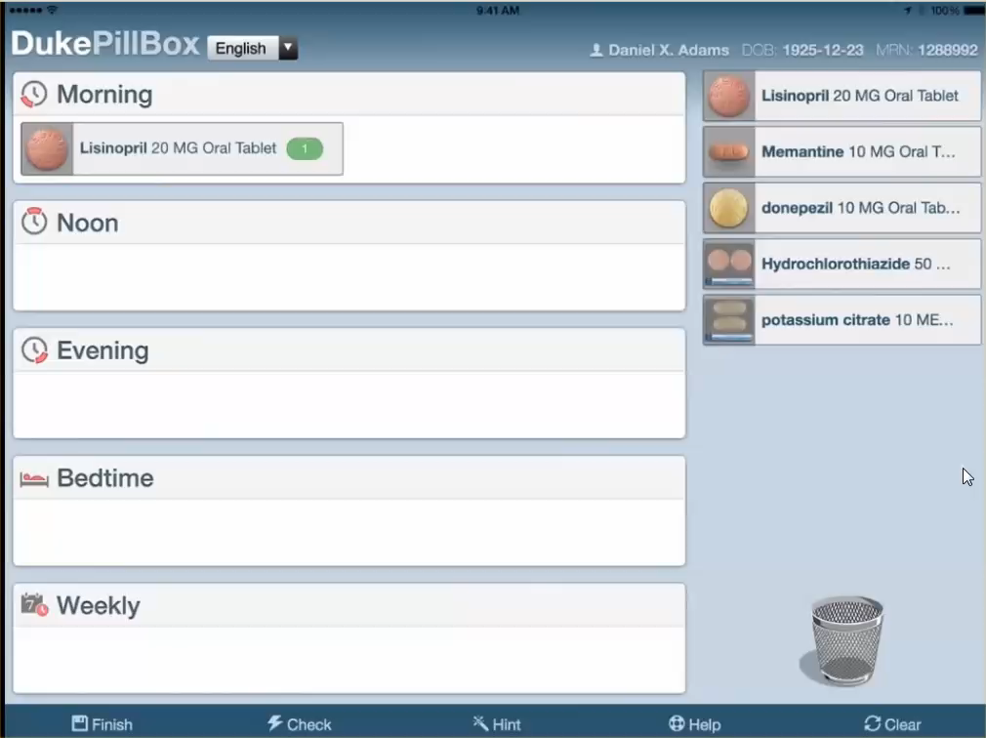
Pillbox

